Slide 1
CPE 503 PRESENTATION
ON
Development of an mHealth System to Improve Antenatal Care
Name: ABIOYE OBALOLUWA P
MatricNo: CSC/2014/002
Supervisor: Dr I.P Gambo

Slide 2
Presentation Outline
INTRODUCTION
LITERATURE REVIEW
STATEMENT OF PROBLEM
AIM AND OBJECTIVES
METHODOLOGY
JUSTIFICATION
SCOPE OF PROJECT
DESIGN SPECIFICATION
EXPECTED CONTRIBUTION TO KNOWLEDGE
CONCLUSION
REFERENCES

Slide 3
INTRODUCTION
Around the world, about 287,000 women die every year from mostly preventable entanglements related to pregnancy and childbirth with Africa bearing the highest burden of maternal deaths (WHO, 2012) and Nigeria accounting for about 10-14% of the recorded death (WHO, 2005; Hil et al., 2007; FMOH, 2005).
Major mortality rate related to pregnancy and childbirth can be avoided if the women received adequate and timely antenatal care using ICT as a facilitator.
Evidence suggests that providing expectant mothers with adequate maternal care using ICT as a medium, birth supervision by skilled attendants, and access to emergency obstetric care in pregnancy and delivery can save lives (Freedman et al., 2007; Obiad, 2007; Starrs, 2007).

Slide 4
INTRODUCTION(CONT’D)
Antenatal care (ANC) is a major public health intervention that caters for a pregnant woman throughout her gestation period and is aimed at guaranteeing safe pregnancy results. In Nigeria, the recommended minimum of four times ANC attendance is underutilized due to many reasons (Adewuyi et al, 2018).
One reason for underutilizing ANC is that most of the working class expectant mothers always find it difficult to undergo the proper and recommended antenatal care due to their busy schedules which brings about the need for a mobile health system for antenatal care.
Mobile health (m-Health) involves utilizing specialized gadgets like mobile telephones, personal digital assistant as well as developing web and mobile applications to meet the need of health care specialists and other consumers (Menaka et al., 2017).

Slide 5
LITERATURE REVIEW TABLE
S/N | Author/Title | Problem | Methodology | Solution/Results | Comments
1 | Lund et al. (2015): Mobile phones to improve antenatal care attendance in Zanzibar | The declining nature of antenatal care attendance as well as quality of the care provided. | Mobile phones were provided for the pregnant women and healthcare agents, then a software that automatically sends reminder messages to the registered phone numbers was developed. | The mobile phone intervention resulted to an increase in antenatal care attendance and easy communication between the women and health agents. | The developed system significantly increased the proportion of women receiving the antenatal care. However, it doesn’t reduce the waiting time at the hospitals but rather increases it.

Slide 6
LITERATURE REVIEW TABLE
S/N | Source | Problem | Methodology | Solution/Results | Comments
2 | Oyeyemi and Wynn (2014): Giving cell phones to pregnant women and improving services may increase primary health facility utilization | The high rate of maternal death in Ondo State as well as delays in seeking healthcare. | Sample retrospective data was collected from hospital records and patient’s case files which was used to determine healthcare facility rate in different locations. After which Closed-Users’ group (CUG) phones were given to pregnant women and health workers. Through these phones, the women could communicate free of charges with the healthcare services. | There was increase access to health services, increase health facility utilization and reduced missed medical appointments. | Providing CUG cell phones to pregnant women led to express communication with the healthcare team in times of emergency. However, it didn’t cater for delay at the primary health care level.

Slide 7
LITERATURE REVIEW TABLE
S/N | Source | Problem | Methodology | Solution/Results | Comments
3 | Menaka et al. (2017): The role of m-health in providing antenatal care in rural areas | High rate of mortality among pregnant women. | Comparative study was carried out in two different hospitals divided into study and control group, as well as the development of a mobile app for health support. | The study group had more antenatal visits, better correction of anemia and less numbers of patients who were lost to follow up. | The mobile health helped in tracking pregnancy, increased antenatal visits and it helped in timely referrals but does’nt cater for a scheduling an appointment with the health agent.

Slide 8
LITERATURE REVIEW TABLE
S/N | Source | Problem | Methodology | Solution/Results | Comments
4 | Chib and Chen (2011): Midwives with mobiles: A dialectical perspective on gender arising from technology introduction in rural Indonesia. | Poor access to information that would enlighten mid wifes and enable them deliver their best. | Mobile phones were introduced to rural midwives allowing them to contact medical experts and communicate with patients. This study applied a dialectical perspective to supplement the analytical frame of the ICT for healthcare development model by addressing the multi- dimensionality of benefits and barriers. | It was discovered that midwives to had access to clinical data, as well as other critical health informations, and were able to effectively partake in the information sharing community. | It encouraged communication among midwives and doctors and survey the achievability of mobile information gathering.

Slide 9
STATEMENT OF PROBLEMS
Nigeria accounts for approximately 14% of maternal deaths globally due to poor quality of antenatal care.
Due to the busy work schedule and conflict in free time of some pregnant women or obstetricians, visiting the hospitals and waiting in long queues to see an obstetrician is untenable.
Lack of access to antenatal care and under utilization of care. Hence there is a great need to improve antenatal care and link up patients to available obstetricians that would cater for their care directly and effectively without going through the stress of the hospitals.

Slide 10
AIM AND OBJECTIVES
The aim of this project is to develop a system that enables pregnant women to access obstetricians that would be responsible for their antenatal care, thereby improving their antenatal care as well as mitigating the adverse effects caused by their busy schedule.
The Specific objectives are as follows:
i)To gather requirements on Antenatal Care.
ii)To design a model based on (i)
iii)To implement a system based on (ii)
iv)To test the system in (iii)

Slide 11
METHODOLOGY
The requirements for the system would be gathered by interviewing the stackholders involved and a brainstorming session with the Experts would also be conducted to futher elicit the requirements for the antenatal care system.
The proposed system would be designed using visual paradigm.
The implementation would be developed using the following:
  Android Studio to develop the mobile app, XML would be used for the mobile front end, Java and Kotlin would be used for the backend.
  For web application; HTML, CSS, and Javascript would be used for the front end and a python framework(Django) would be used for the backend.
  MySQL would be used for the database.
Unit and Beta Testing would be used to test the system alongside some metrics which includes accuracy, user friendliness, responsiveness and security.

Slide 12
JUSTIFICATION
The proposed system will solve a major health problem among pregnant women that are too busy to go through the stress of a regular appointment with an Obstetrician in the hospital.
It caters for their care directly and effectively, previous methods have always been to get registered in the hospital and get appointments manually which has resulted in delayed service.
Comparing this to the regular queuing method, the system would significantly increase the user’s satisfaction and reduce the total waiting time for antenatal care and medical checkups (Nazia and Ekta, 2014).
It serves as an intermediary between Obstetricians that are in close proximity to a pregnant woman.
The approach proposed saves time and is less stressful for pregnant women.

Slide 13
SCOPE OF THE PROJECT
The system is limited to linking pregnant women and Obstetricians and not including other patients with health related issues.
The system enables pregnant women to schedule appointments with Obstetricians in close proximity to them.

Slide 14
Work Done
Elicited Requirements
Design Specification
  Context Diagram
  System Architecture
  Block Diagram
  Use case Diagram
  Activity Diagram
  Class Diagram

Slide 15
Work Done
Elicited Requirements
  Present the requirements you have collected/gather, the data you will use for the design/model etc

Slide 16
Work Done: Design Specification
Context Diagram
System Architecture
Block Diagram
Use case Diagram
Activity Diagram
Class Diagram

Slide 17
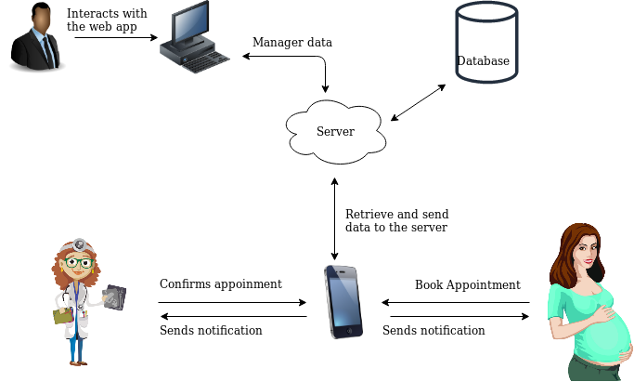
Design Specification(Contd.)
Figure 1: Proposed Context Diagram

Slide 18
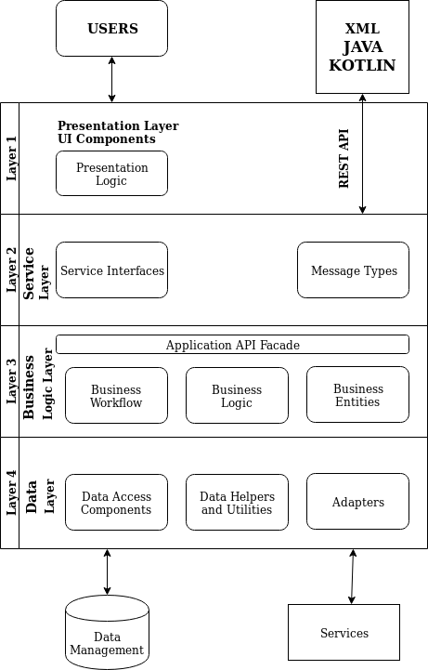
Design Specification(Contd.)
Figure 2: Proposed Mobile System Architecture Diagram

Slide 19
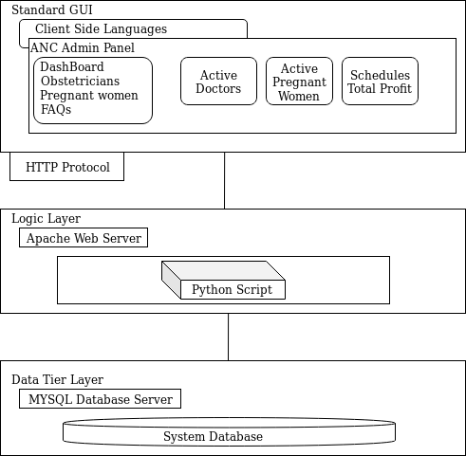
Design Specification(Contd.)
Figure 3: Proposed Context Diagram

Slide 20
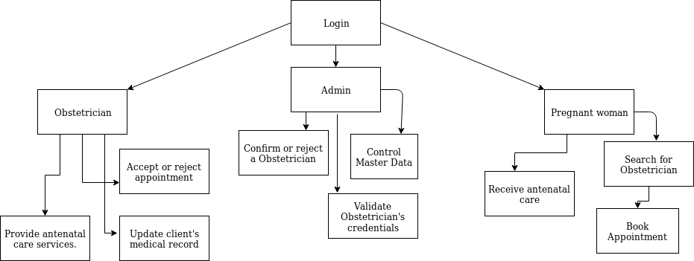
Design Specification(Condt.)
Figure 4: Proposed Block Diagram

Slide 21
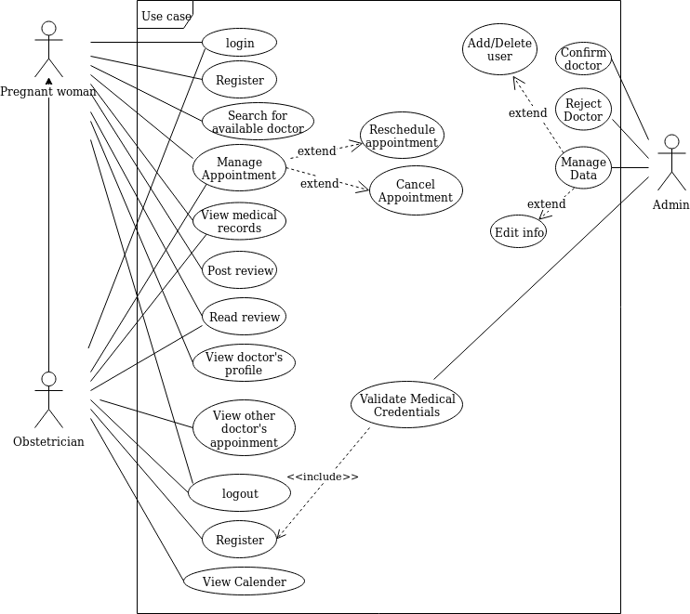
Design Specification(Condt.)
Figure 5: Proposed Use Case Diagram

Slide 22
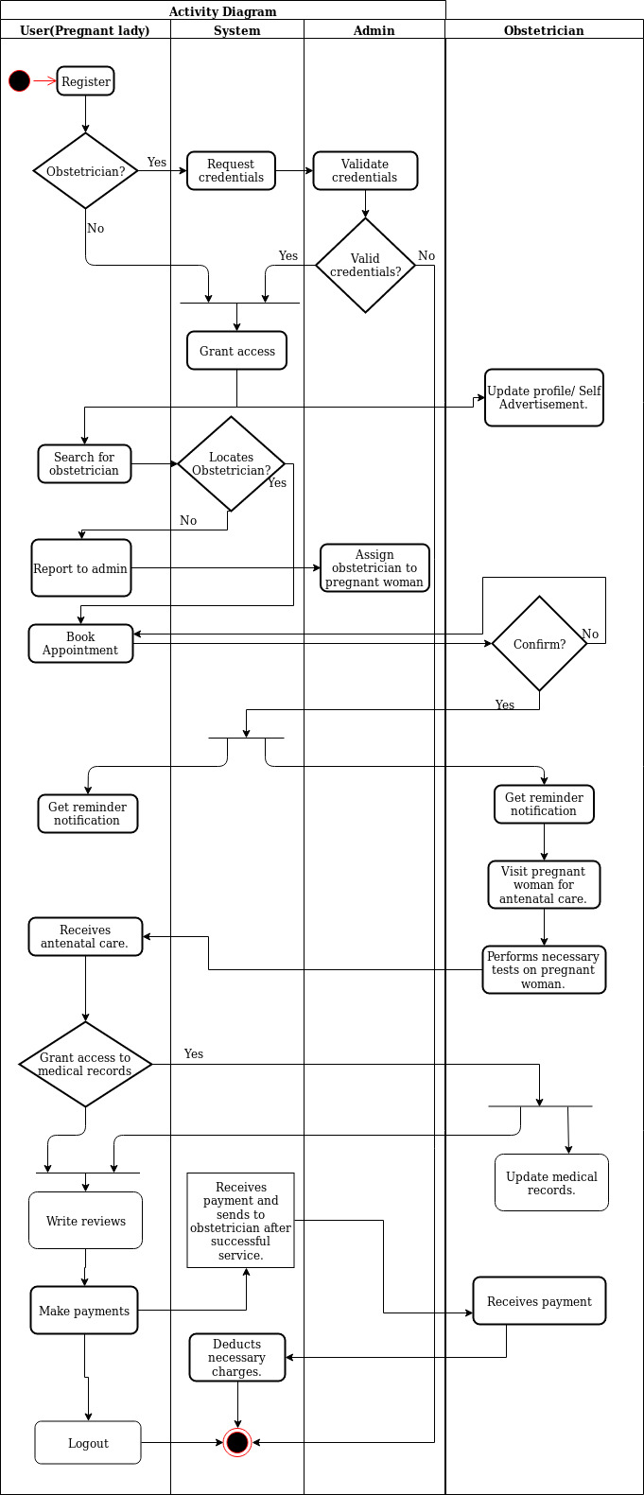
Activity Diagram
Figure 6: Proposed Activity Diagram

Slide 23
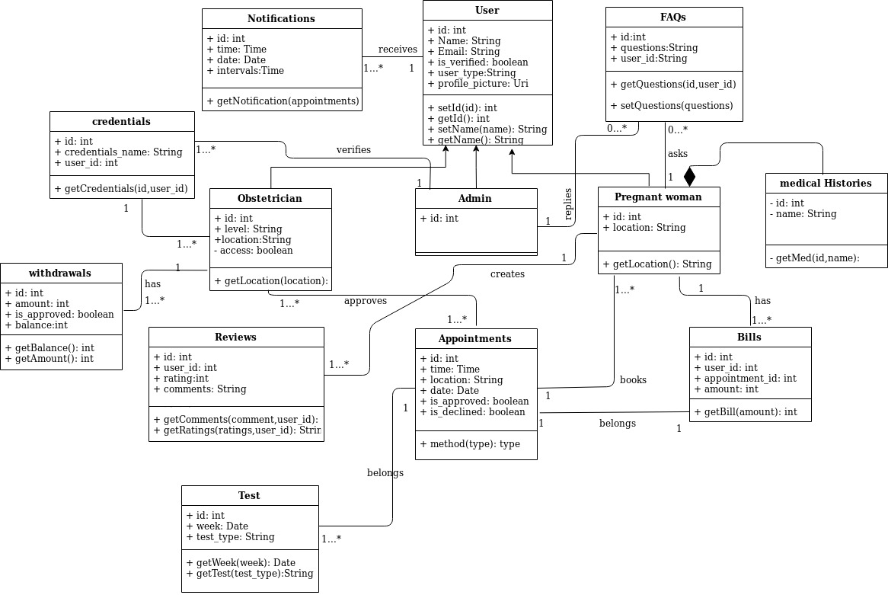
Class Diagram
Figure 7: Proposed Class Diagram

Slide 24
Work Left Undone
Outline what is left to be done to complete the project.
  Analysis
  Implementation – what are the tentative choice of technolog
  Evaluation/Testing.

Slide 25
EXPECTED CONTRIBUTION TO KNOWLEDGE
The project is expected to contribute to knowledge by providing a system:
  That equates pregnant women to outpatients and provides an avenue for them to get medical attention outside the hospital.
  That would harness course plotting technology to determine the most suitable obstetrician based on proximity and route with the aid of google map.

Slide 26
CONCLUSION
The problem statement, aim and objectives, methodology have been identified; the scope and justification have been presented; the proposed design specification are also represented. Thus, the project addresses an optimized method where pregnant women can access obstetricians from any hospital or health related organizations in close proximity to them for a personal check up, there is no need to visit the hospital again until when necessary or if recommended.
In anticipation, the proposed system to be implemented will be flexible, thereby making it easy for the Doctor to see the pregnant woman outside the hospital facilities (House, Office).

Slide 27
REFERENCES
Adewuyi, E.O., Auta, A., Khanal, V., Bamidele, O.D., Akuoko, C.P. and Adefemi, K. (2018). “Prevalence and factors associated with underutilization of antenatal care services in Nigeria: A comparative study of rural and urban residences based on the 2013 Nigeria demographic and health survey”. PLoS ONE 13(5), pp. 255-303 .
Chib, A., Chen, V.H.H. (2011). “Midwives with mobiles: a dialectical perspective on gender arising from technology introduction in rural Indonesia”. New Media Society. 13(3), pp. 486-501.
Federal Ministry of Health (FMOH) Nigeria (2005). “Road map for accelerating the attainment of the millennium development goals related to maternal and newborn health in Nigeria.” Federal Ministry of Health.

Slide 28
REFERENCES
Freedman, L., Graham, W., and Brazier, E. (2007). ”Practical lessons from global safe motherhood initiatives: time for a new focus on implementation”. Lancet, 370 pp. 383–391.
Hill, K., Thomas, K., and Abou, Z.C., On behalf of the Maternal Mortality Working Group, et al. (2007). “Estimates of maternal mortality worldwide between 1990 and 2005: An assessment of the available data.” Lancet, 370, pp. 1311–1319.
Lund, B.,Nielsen B., Hemed M., Boas I.M., Said A. and Said K., (2014). "Mobile phones improve antenatal care attendance in Zanzibar: a cluster randomized controlled trial," BMC pregnancy and childbirth, 14, pp. 29-40.

Slide 29
REFERENCES
Menaka, B., Kamineni M.V., (2017) ‘The role of m-health in providing antenatal care in rural areas’. International Journal of Reproduction, Contraception, Obstetrics and Gynecology. 6(9), pp 4059.
Nazia S., Ekta S., (2014). “Online Appointment Scheduling System for Hospitals–An Analytical Study”. International Journal of Innovations in Engineering and Technology (IJIET). 11, pp. 98-108.
Obaid, T., (2007). “No woman should die giving life”. Lancet, 370, pp. 1287–1288.
Oyeyemi, S.O. and Wynn R., (2014) "Giving cell phones to pregnant women and improving services may increase primary health facility utilization: a case–control study of a Nigerian project," Reproductive health, 11, pp. 8.
Starrs, A., (2007). “ Delivering for women”. Lancet, 370, pp. 1285–1287.

Slide 30
REFERENCES
Tufail M., (2018). ‘Online Polyclinic appointment and database management system’ Unpublished M.Sc. Thesis, Department of Information Technology, Tampereen University of Applied Sciences.
World Health Organisation. “Maternal mortality Fact”. May 2012. Accessed on July 20, 2019 at: http://www.who.int/mediacentre/factsheets/fs348/en/index.html.
World Health Organization and UNICEF. Maternal,newborn and child survival. Geneva & New York: Coordination Committee; 2012. Accessed on 5th of July 2019 http://www.countdown2015mnch.org/documents/2012Report/2012-complete-no profiles.pdf.
World Health Organisation: Maternal mortality in 2005: estimates developed by WHO, UNICEF, UNFPA, and the World Bank. Geneva: WHO; 2007.

